Slide 1
Minstead Community Shop
Tim Nicholson
Chair
Minstead Community Shop Working Group

Slide 2
Topics
Designs by Eleni Pappadopoulou of Fairhurst Design Group
Working Group Membership
Update on progress on Community Shop in Minstead
Finance/outline cost

Slide 3
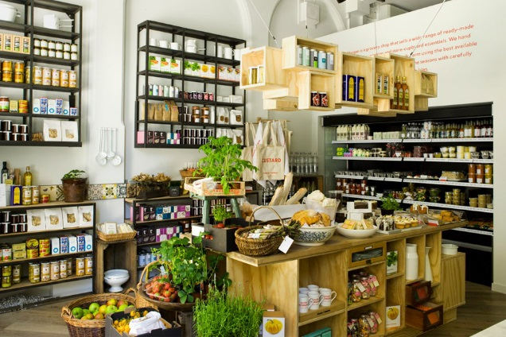
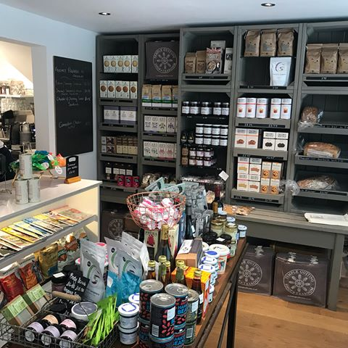
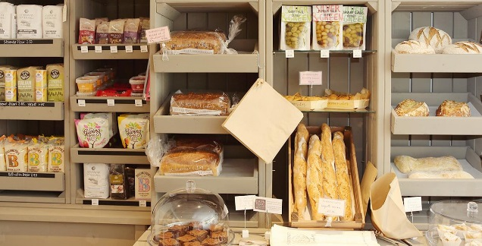
Tall fridge location
Work bench with coffee machine, sink, undercounted fridge etc.
Servery/ till location
Shelving
Shelving
Seating area by the window
Entrance door location
External produce display area
© Fairhurst Design Group
Plan

Slide 4
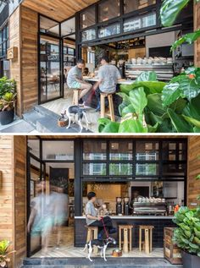
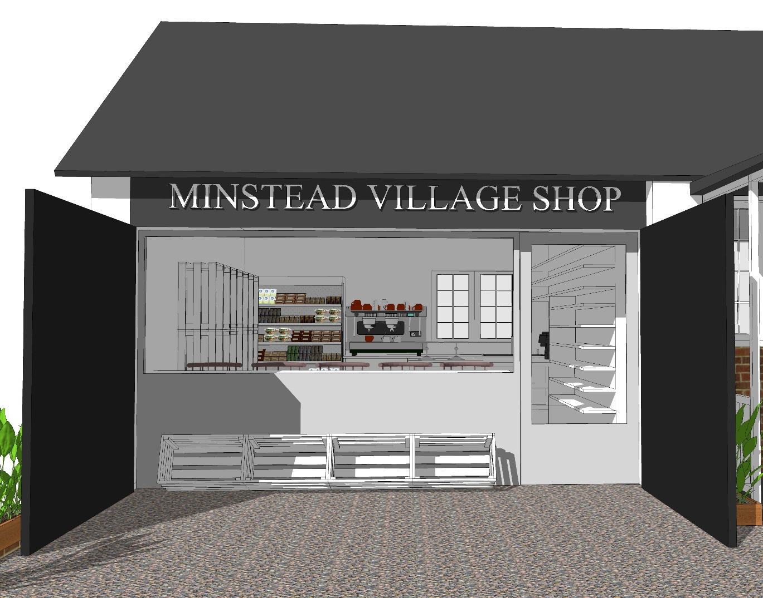
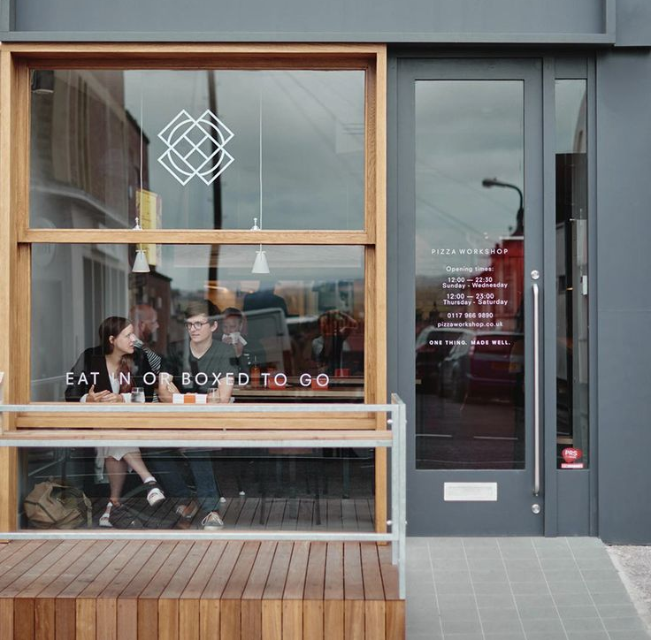
New sign
New timber frame window and door
Shelving
Existing black painted timber doors to be used as sales display
Entrance door location
External produce display area
© Fairhurst Design Group
Elevation

Slide 5
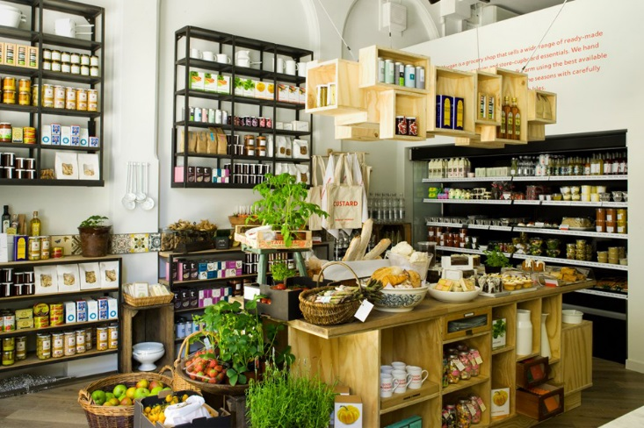
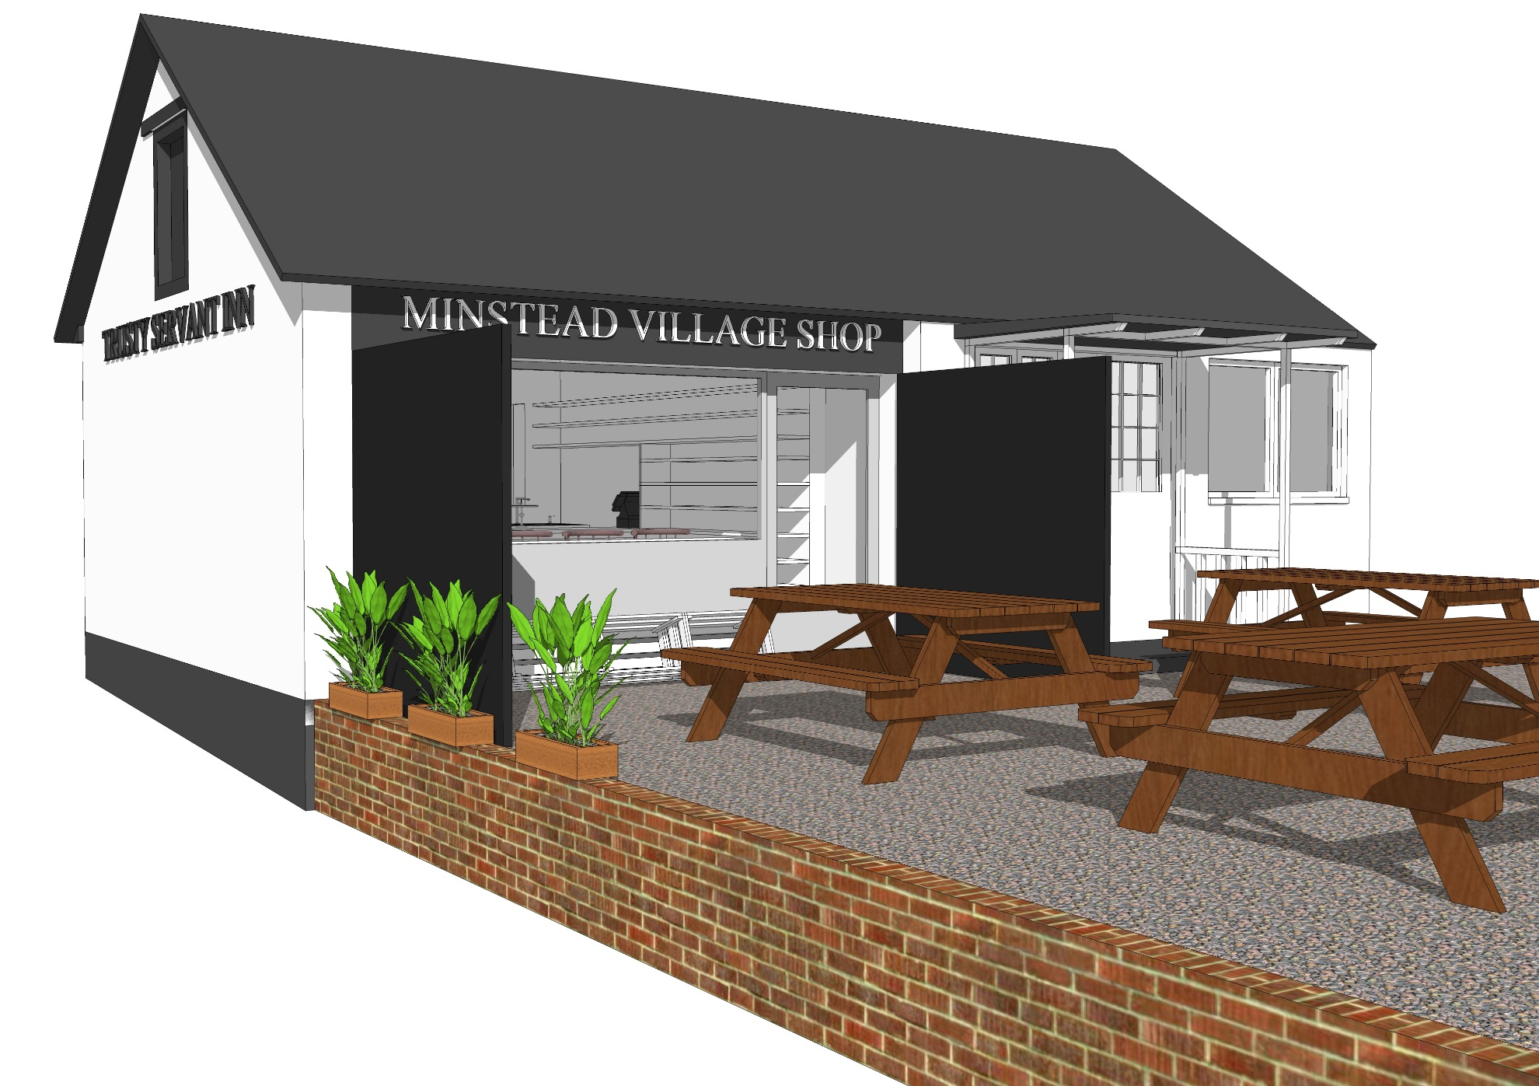
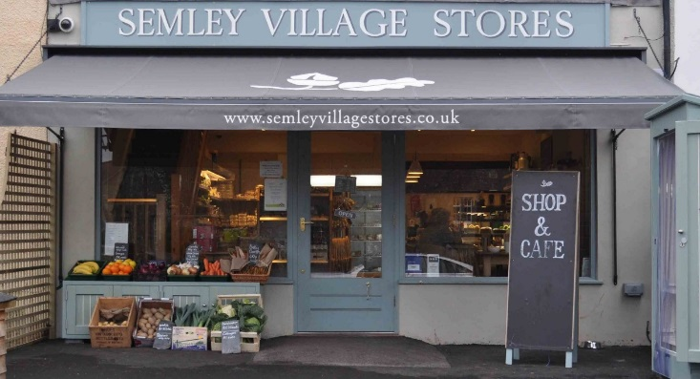
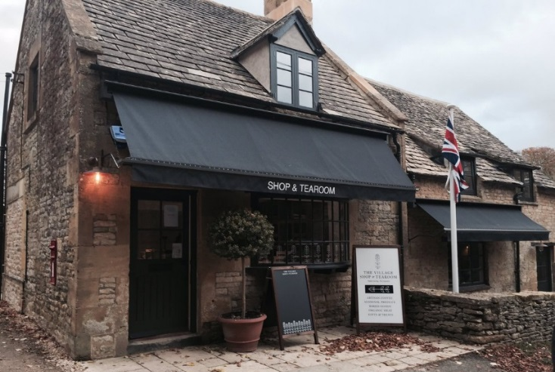
© Fairhurst Design Group
External view

Slide 6
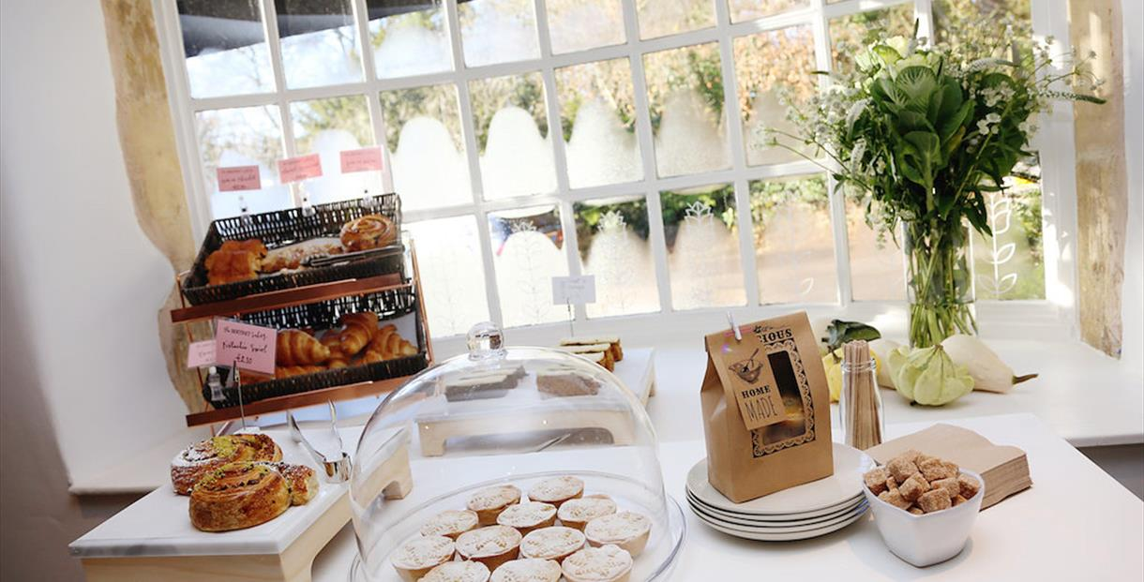
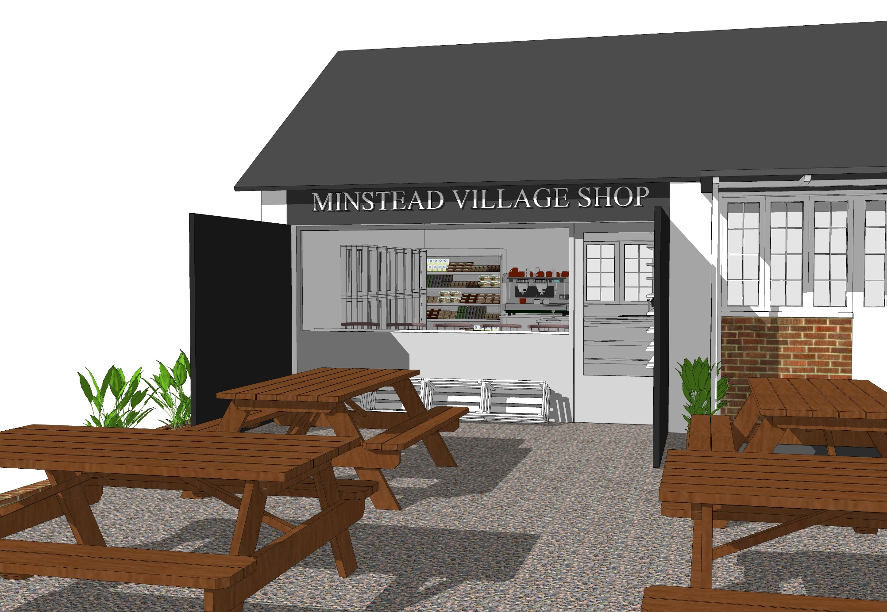
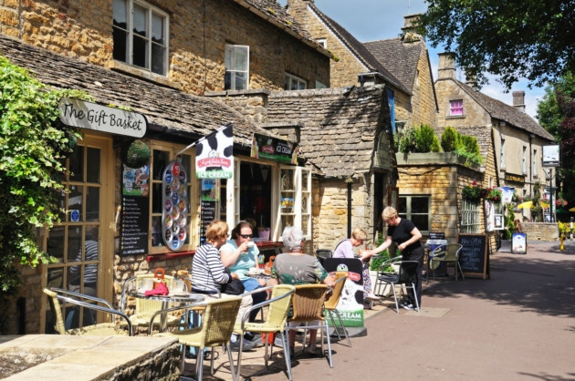
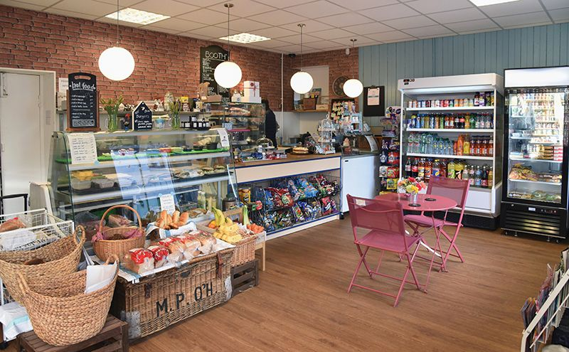
© Fairhurst Design Group
External view

Slide 7
Working Group Membership
Chair – Tim Nicholson
Treasurer/Finance Lead – Peter Johnson
Secretary – Jenni Cavanna
Legal – Alison McGhee
Business Planning – Tim Nicholson
Fund Raising – Annabel Bruxner-Randall
Communications/Marketing – Lance McArdell
Buildings – Nib Saunders
Parish Council Liaison – Alan Ferguson/Dawne Wakelin
Other members – Spike Briggs, Jo Vardy, Yvonne Le Brun, David Potterton

Slide 8
Working Group Actions
Location – agreed with the Trusty Servant to use a space in the pub for the shop. A location on the village green.
Negotiating a lease/licence with Ei Group and Debbie & Duane Lewis
Assessed the refurbishment of the pub space.
Opened a bank account.
Joining the Plunkett Society.
Registering with FCA as a Community Benefit Society.
Fund raising, e.g. Village Quiz, Pop-up café/shop on the village green, grants.

Slide 9
Tasks ahead
Finalise a costed Business Plan & schedule for development
Raise funds – share issue, gifts, fund raising activities
Apply for funding grants (matched funds)
Resolve any planning issues for shop
Refurbish the pub space including Electricity, Water, WiFi
Fit the shop out
Recruit at least 30 volunteer staff
Stock the shop
Run the shop

Slide 10
Operational management
Majority run and managed by the community
Be a focus in the village
Operated entirely by volunteers.
Sell tea, coffee and cakes
Sell basic needs for when you run out
Non-perishable staples
Sell village & local produce
Information Point for visitors

Slide 11
Finance
Some grants may be available through the Hampshire CC and other charitable bodies. These are usually matched funding.
People in the village making donations & buying shares.
Fund raising through village activities.
The Community Shop will be a “not for profit” organisation but will need to raise sufficient operational funds to maintain its existence over many years, including for re-investment.

Slide 12
Outline set up costs
Item | Cost £
Costs of setting up legal entity | £ 310.00
Annual Subscription to Plunkett (1st year) | £240.00
Planning Permission application | £ 150.00
Legal costs in setting up lease/licence | £5,000.00
Refurbishment of pub storeroom | £14,020.00
Fit out the shop | £1,000.00
Equipment (e.g. Refrigerator/chiller, coffee machines, EPOS) | £4,500.00
Publicity & Advertising | £1,000.00
Signage | £500.00
Initial stock for the shop | £2,000.00
Insurance (1st year) | £600.00
Newspaper deposit (1st year) | £1,000.00
Opening Cash Float | £500.00
TOTAL | £30,820.00
Contingency (10%) | £3,082.00

Slide 13
Years 1 - 3 business plan
Item | Set-up | Year 1 | Year 2 | Year 3
Grants | £12,000.00
Share Issue/Donations | £25,000.00
Total Income | £37,000.00 | £60,000.00 | £66,000.00 | £72,600.00
Set-up Costs | £30,820.00
Cost of Sales | 0.00 | £50,588.00 | £56,477.00 | £62,030.00
Taxes | 0.00 | -£1,066.00 | -£1,087.00 | -£1,285.00
Total Expenditure | £30,820.00 | £51,654.00 | £57,563.00 | £63,316.00
Cash Movement | £6,180.00 | £8,346.00 | £8,437.00 | £9,284.00
Closing Balance | £6,180.00 | £14,526.00 | £22,963.00 | £32,247.00
Depreciation of Fixed Assets | £0.00 | £3,904,00 | £3,904,00 | £3,904,00

Slide 14
Thank you for listening

